Slide 1
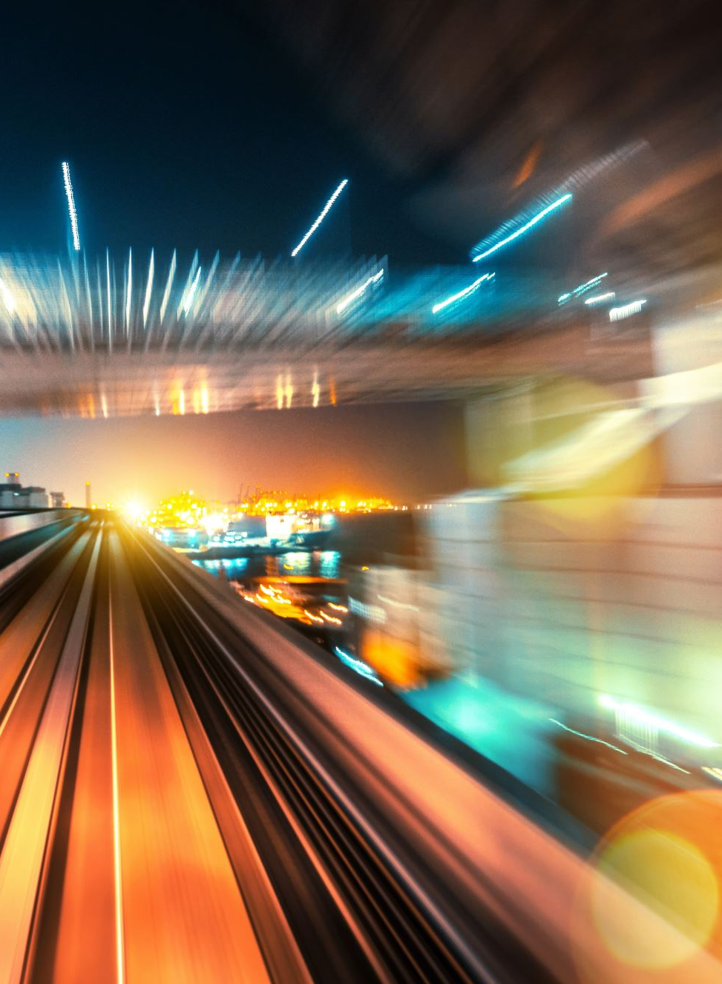
Super-resolution motion deblurring
Physics 305 Activity 1
2nd Sem AY 2022-2023
Mark Jeremy G. Narag
2014-64423
PhD Physics

Slide 2

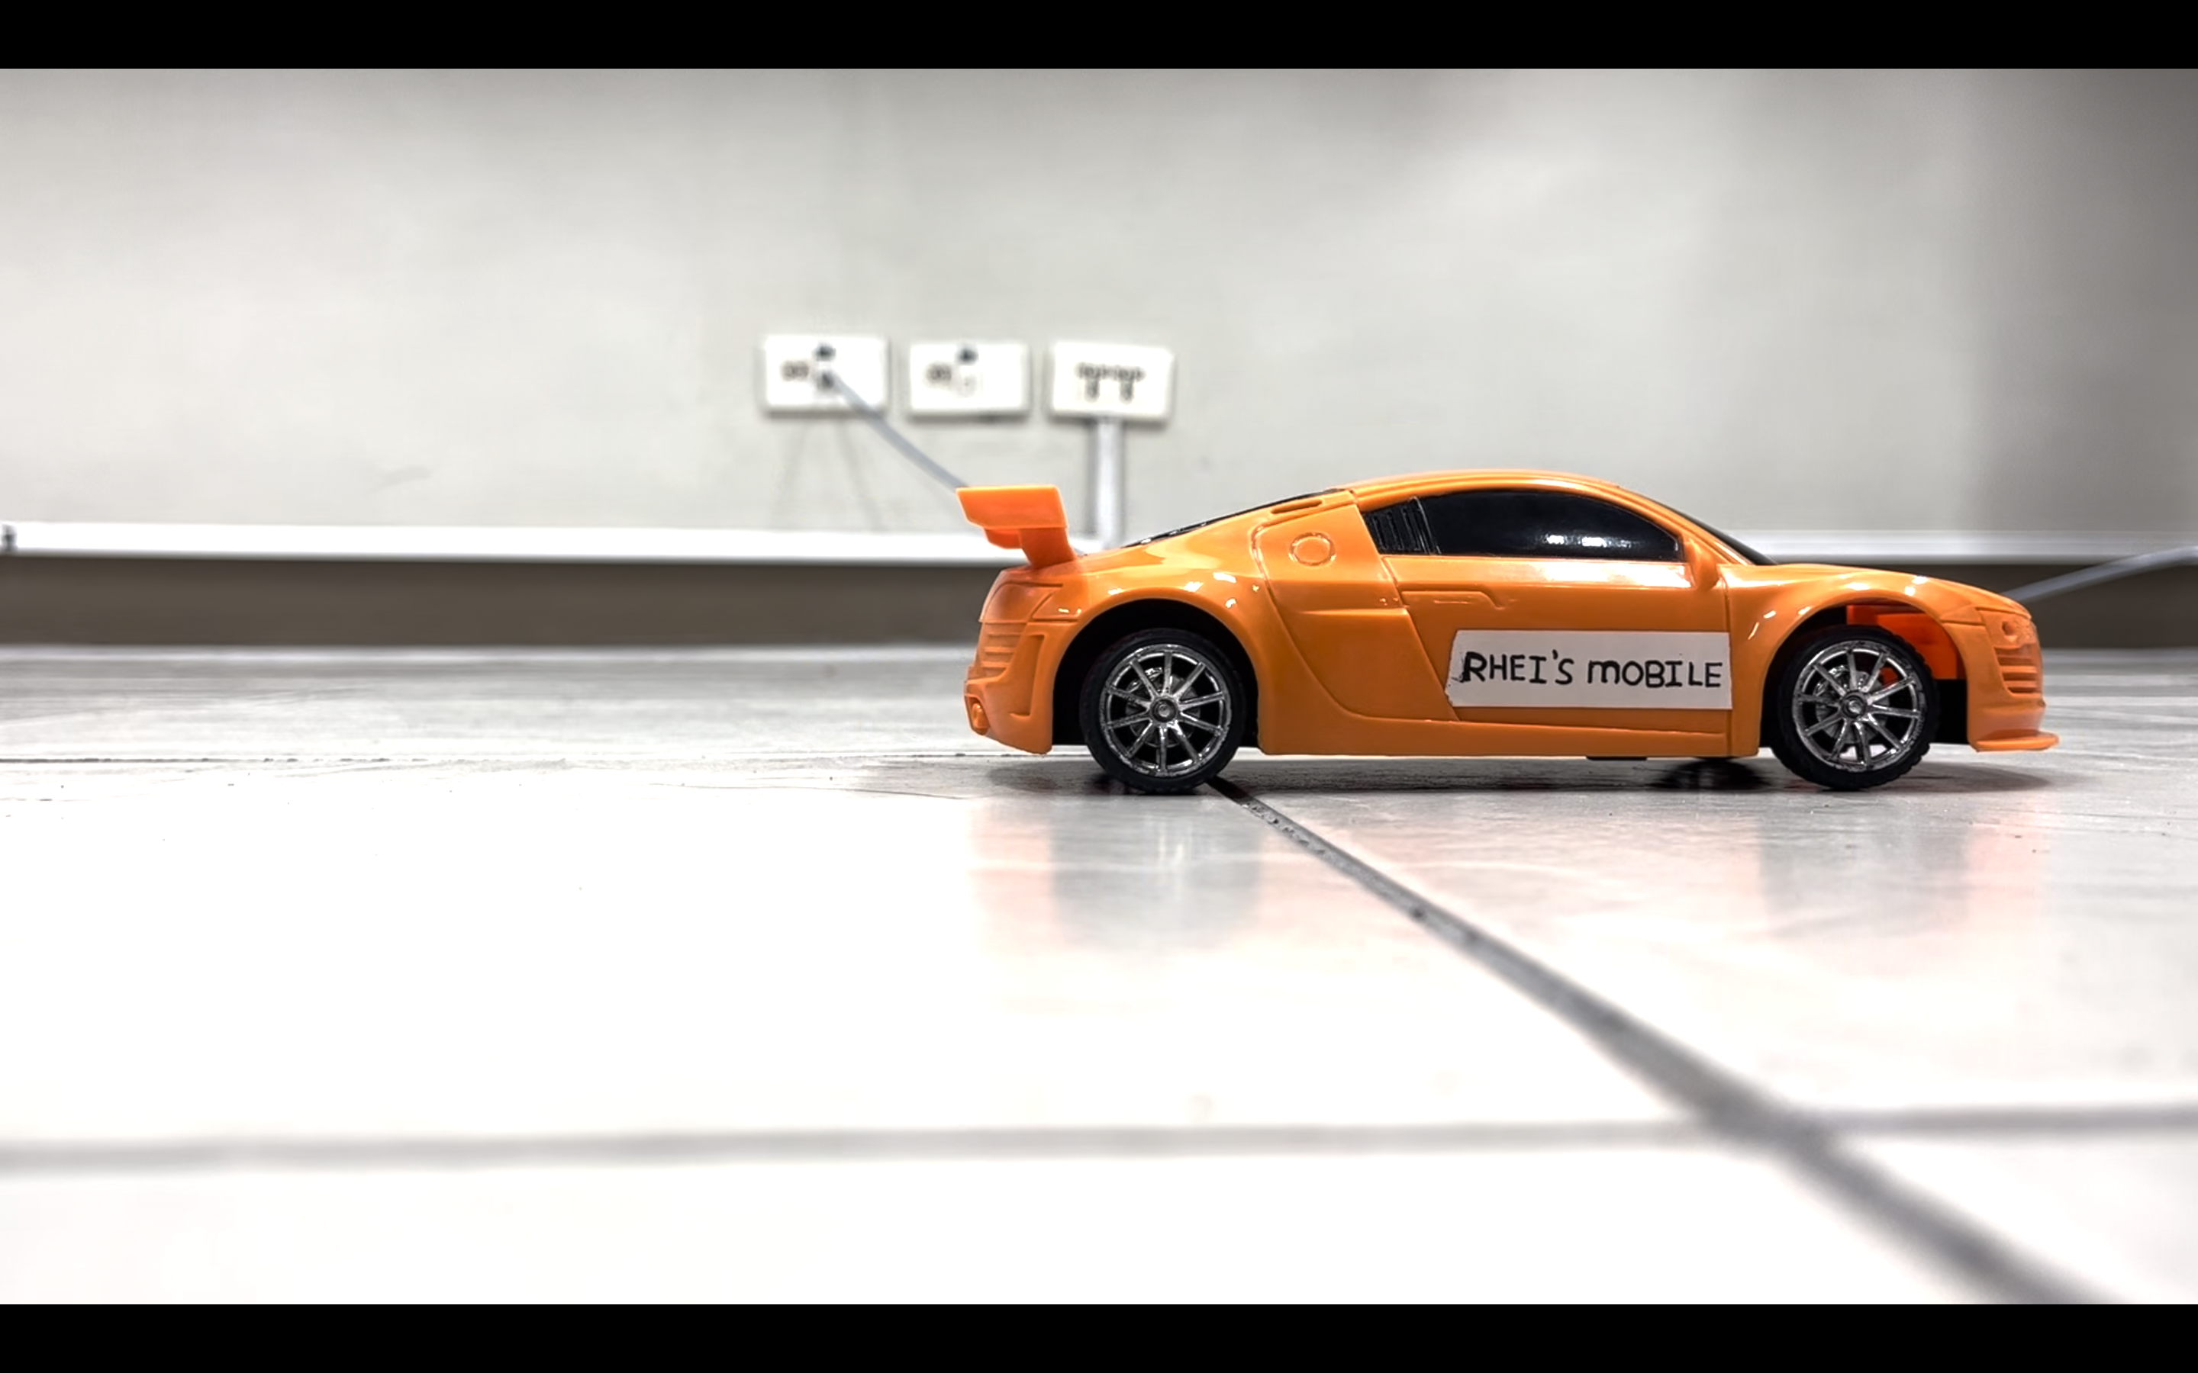





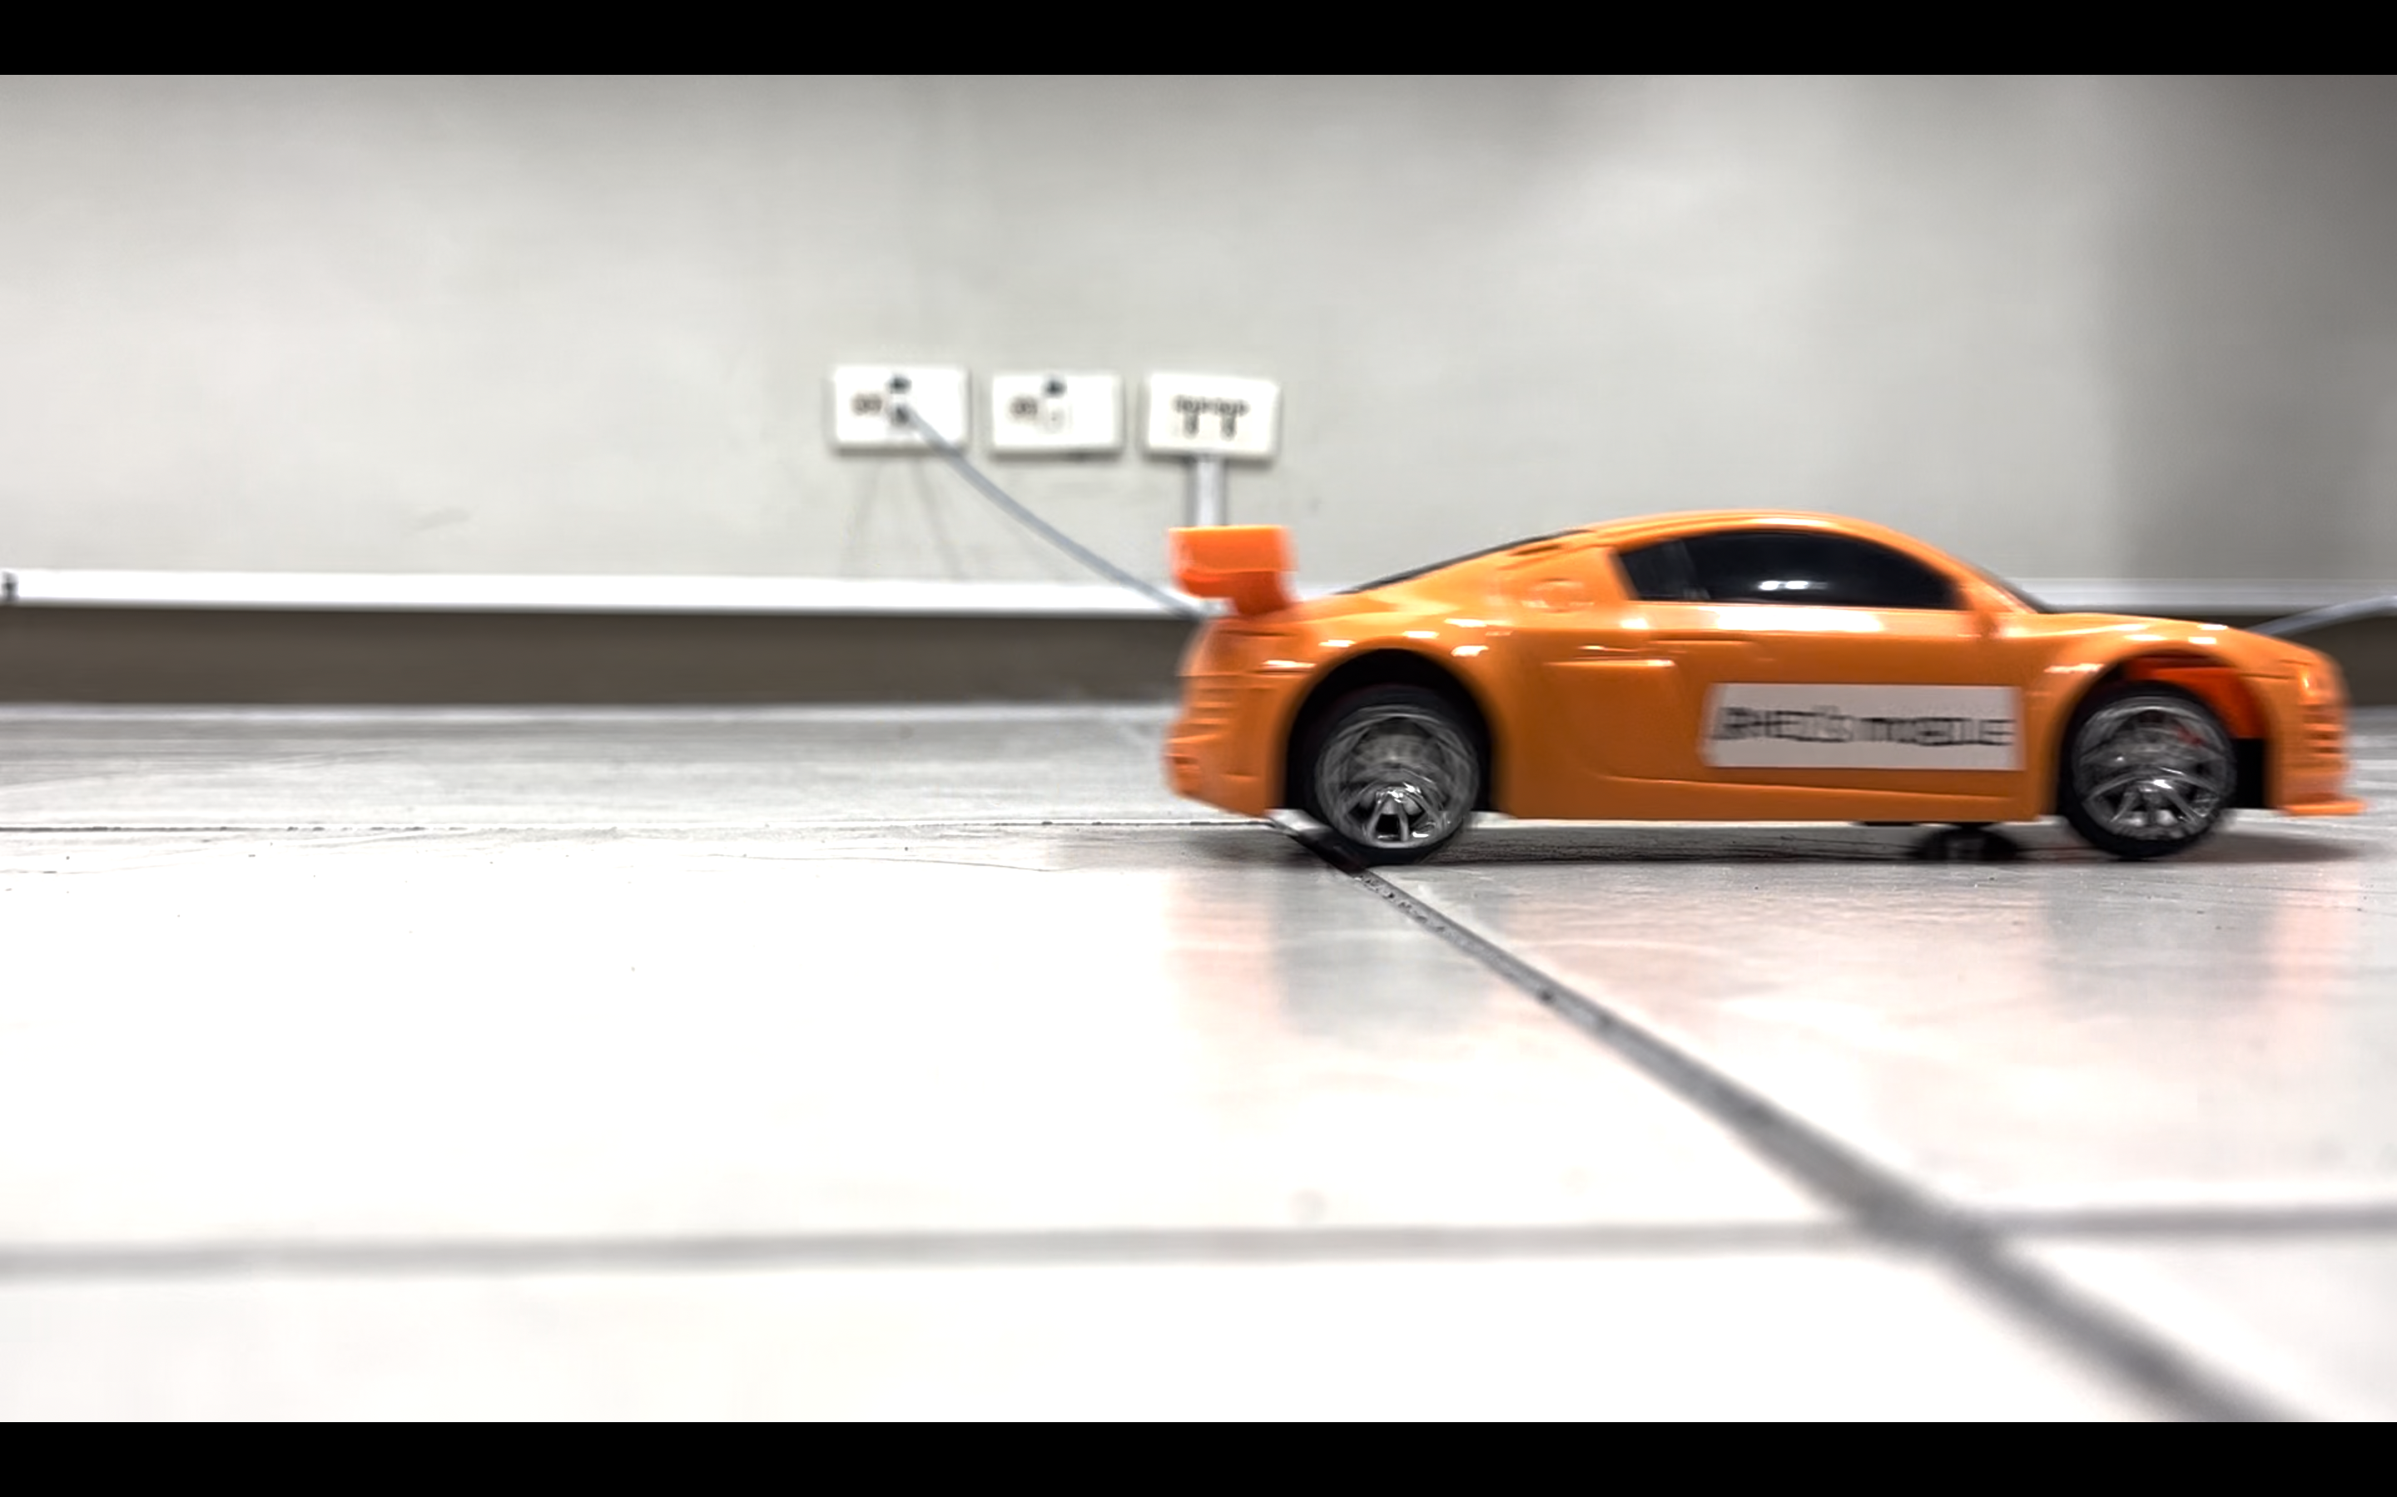


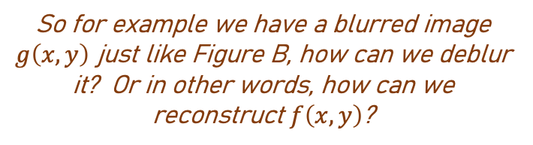
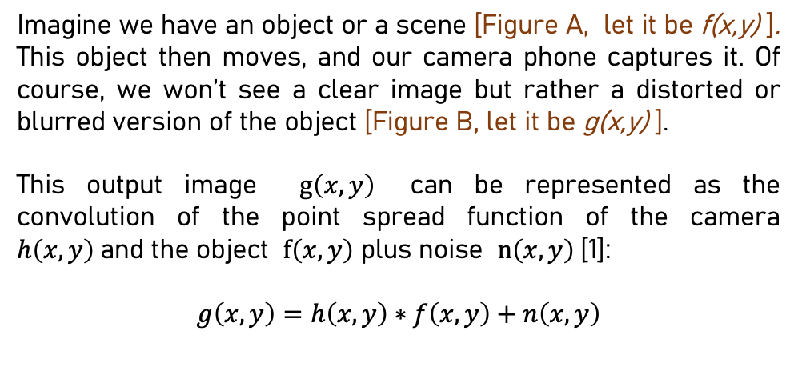
This is a screenshot of a
still toy car in a video…
How can we deblur an image?
Imagine we have an object or a scene [Figure A, let it be f(x,y) ]. This object then moves, and our camera phone captures it. Of course, we won’t see a clear image but rather a distorted or blurred version of the object [Figure B, let it be g(x,y) ].
This output image $g\left(x,y\right)$ can be represented as the convolution of the point spread function of the camera $h\left(x,y\right)$and the object $f\left(x,y\right)$ plus noise $n\left(x,y\right)$[1]:
$$g\left(x,y\right)=h\left(x,y\right)∗f\left(x,y\right)+n\left(x,y\right)$$
Figure A
…and this is a screenshot of the
moving toy car in a video…
it’s blurred!
So for example we have a blurred image $g\left(x,y\right)$ just like Figure B, how can we deblur it? Or in other words, how can we reconstruct $f\left(x,y\right)$?
One way is through….
Minimum Mean Square Error (Wiener) filtering
Figure B
[1] Soriano, M. 2023. Super-resolution Motion Deblurring. Physics 305 Computational Imaging

Slide 3
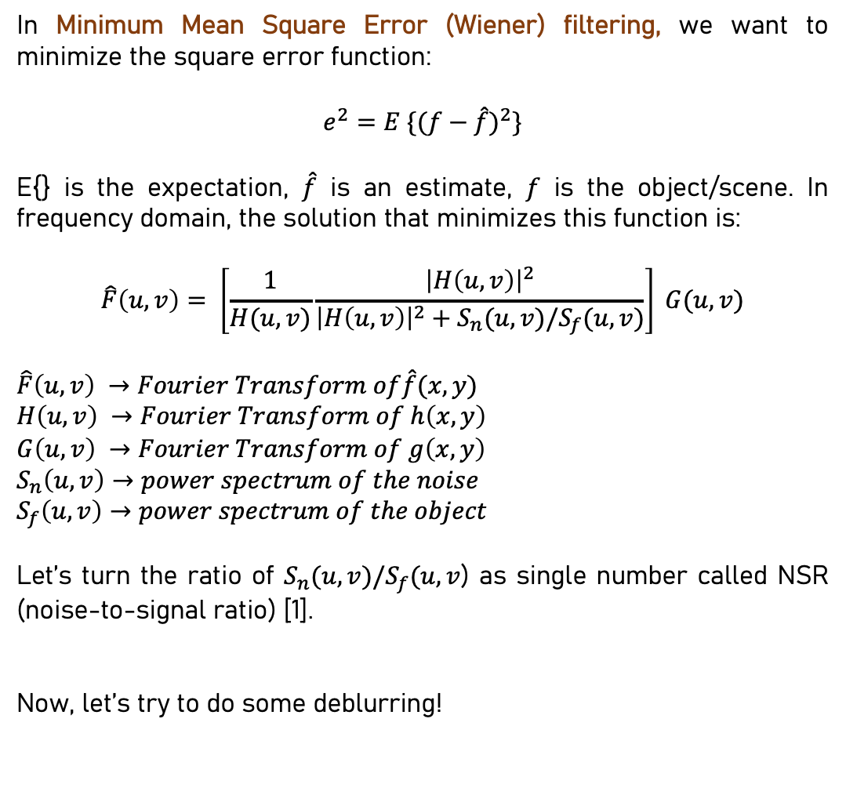
This is a screenshot of a
still toy car in a video…
How can we deblur an image?
In Minimum Mean Square Error (Wiener) filtering, we want to minimize the square error function:
$$e^{2}=E \{{(f−\hat{f})}^{2}\}$$
E{} is the expectation, $\hat{f}$ is an estimate, $f$ is the object/scene. In frequency domain, the solution that minimizes this function is:
$$\hat{F}\left(u,v\right)= \left[\frac{1}{H(u,v)}\frac{{\left|H\left(u,v\right)\right|}^{2}}{{\left|H\left(u,v\right)\right|}^{2}+S_{n}(u,v)/S_{f}(u,v)}\right] G(u,v)$$
$$\hat{F}\left(u,v\right) →Fourier Transform of\hat{f}(x,y)$$
$$H\left(u,v\right) →Fourier Transform of h\left(x,y\right)$$
$$G\left(u,v\right) →Fourier Transform of g\left(x,y\right)$$
$$S_{n}\left(u,v\right)→power spectrum of the noise$$
$$S_{f}\left(u,v\right)→power spectrum of the object$$
Let’s turn the ratio of $S_{n}(u,v)/S_{f}(u,v$) as single number called NSR (noise-to-signal ratio) [1].
Now, let’s try to do some deblurring!
Figure A
…and this is a screenshot of the
moving toy car in a video…
it’s blurred!
Figure B
[1] Soriano, M. 2023. Super-resolution Motion Deblurring. Physics 305 Computational Imaging

Slide 4

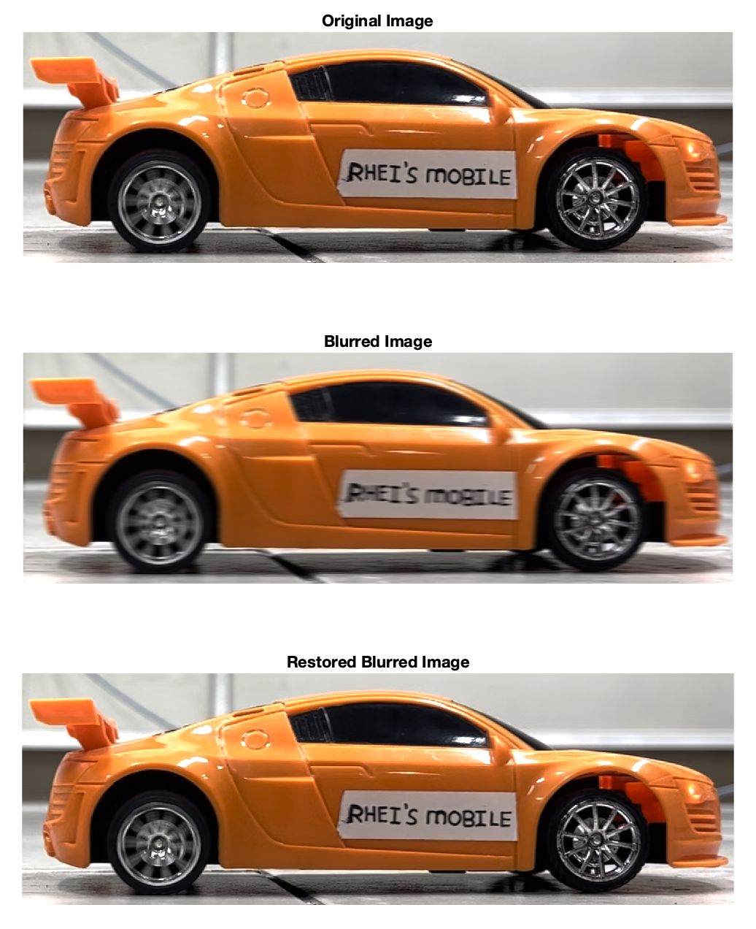
Deblur images using Wiener filter There is already a Matlab functions that performs Wiener filtering – deconvwnr:
J = deconvwnr(I,psf,nsr)
The above function deconvwnr returns a deblurred image J of a blurred image I. Image I is being convolved with the point-spread function psf. In addition, there is an additive noise given by the noise-to-signal power ratio nsr [2].
Here is an example of a Matlab code that uses the above function. Now, let’s apply it to our own pictures. Before we use blurred images tho, let’s try synthetically blur a clear image first. We should be able to reconstructed the original.
MATLAB code
figure();
Ioriginal = imread('non_blur.png');
subplot(131); imshow(Ioriginal); title('Original Image’)
PSF = fspecial('motion',15,0);
Idouble = im2double(Ioriginal);
blurred = imfilter(Idouble,PSF,'conv','circular');
subplot(132); imshow(blurred); title('Blurred Image’)
wnr1 = deconvwnr(blurred,PSF);
subplot(133); imshow(wnr1); title('Restored Blurred Image')
Shown in Figure 1 is an example of synthetically blurring Rhei’s mobile car then deblurring it. We did not add noise here yet. As we can see, we were able to successfully deblur it because we already know the PSF that we used for blurring it.
Figure 1. Blurring and deblurring a still image. Blurring the original image with PSF pixel offset = 15, angle = 0
[2] https://www.mathworks.com/help/images/ref/deconvwnr.html

Slide 5
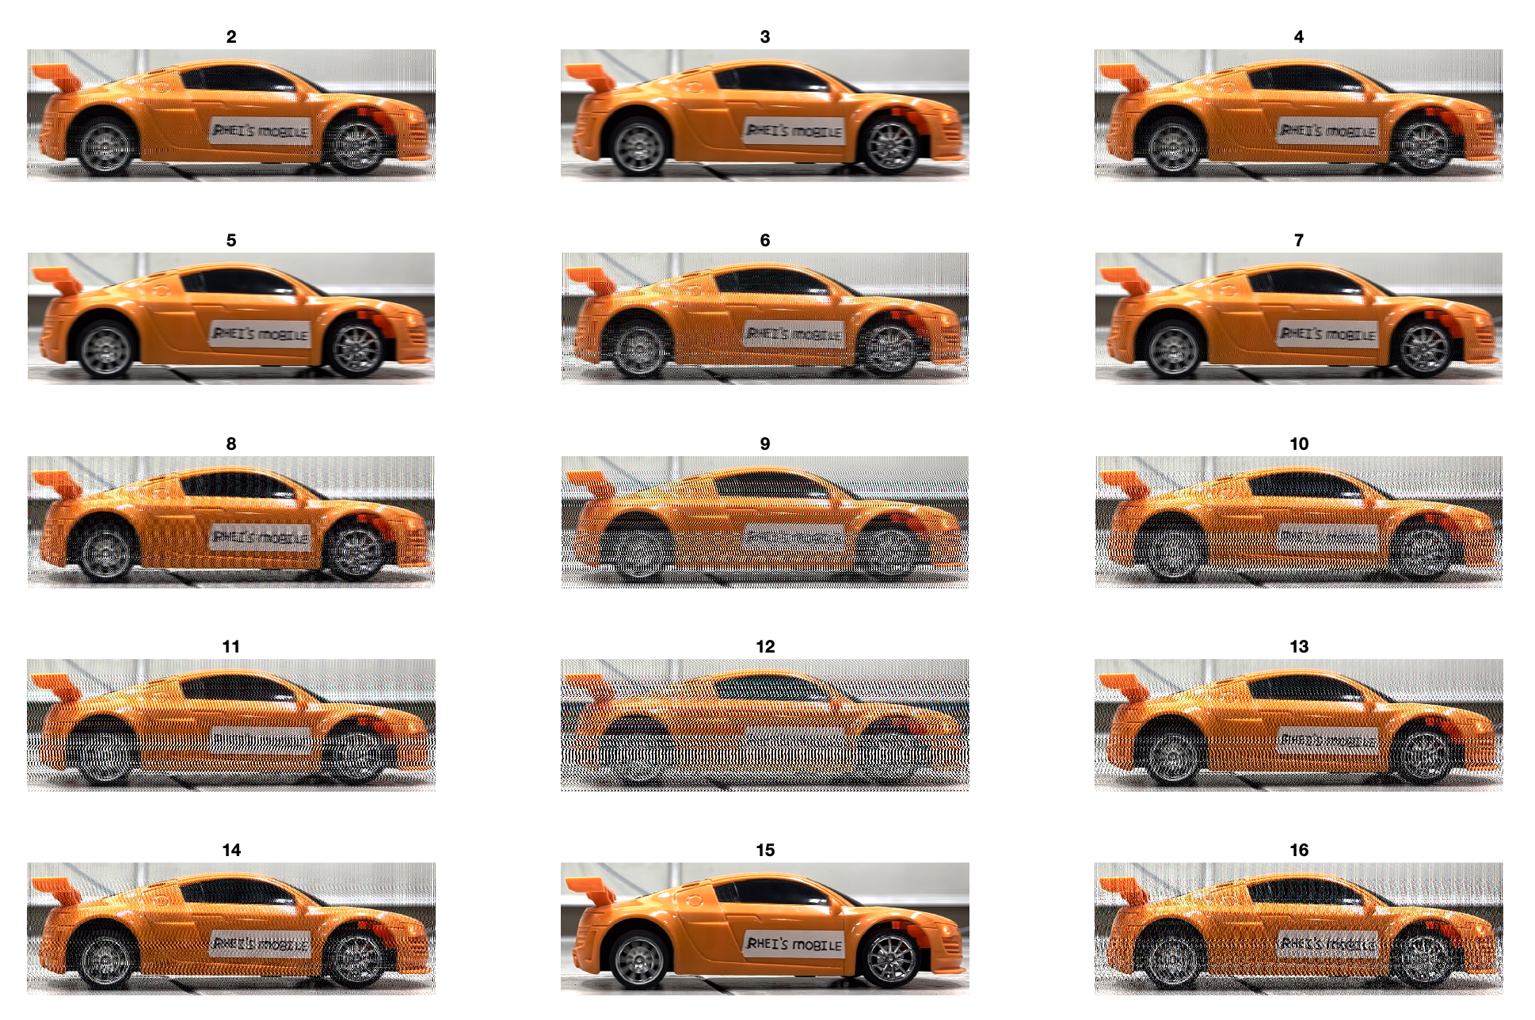
Part 1: Deblurring a synthetic blurred image
But how about when we don’t know the PSF? And we are left to randomly guess the pixel offset and angle? Shown in Figure 2 is the restored blurred images for varying pixel offset. As we can see, if we don’t know the PSF, it will be a trial-and-error approach. One can pre-conclude that the best reconstruction is on PSF pixel offset = 7.
Figure 2. “Guessing” the correct pixel offset by manually investigating the restored version from different values of pixel offset

Slide 6
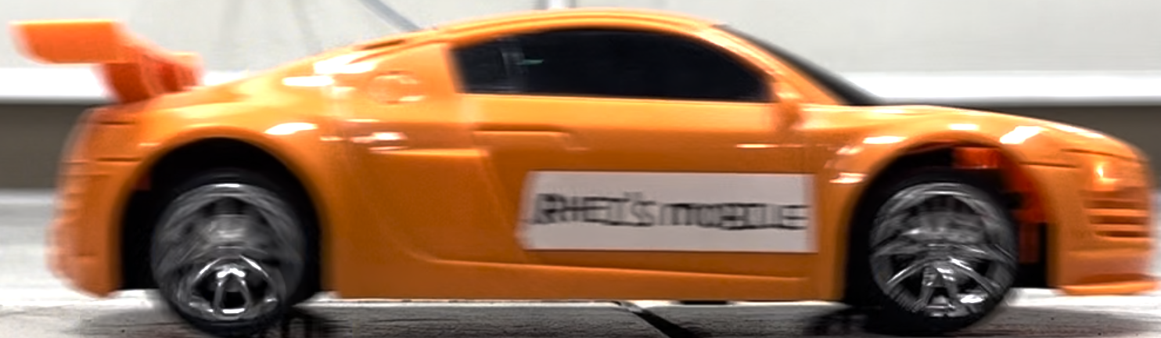
Part 2: Deblurring a real blurred image
Now let’s try the blurred a while ago (Figure B):
MATLAB code
Blurred_img = imread('Blur_test_2.png');
figure(); t = tiledlayout(10,6, 'TileSpacing','none','Padding','compact');
for pix=23:1:32
for NSR = 0:0.01:0.05
PSF = fspecial('motion',pix,0);
wnr1 = deconvwnr(Blurred_img,PSF,NSR);
nexttile; imshow(wnr1); title(['PSF=',num2str(pix),',NSR=',num2str(NSR)])
end
end
This is not a synthetically blurred image. This is real. It is a screenshot from a video. We really don’t know the PSF on this one, so we are left with randomly guessing the best combination.
On the right is the MATLAB code to do it.

Slide 7
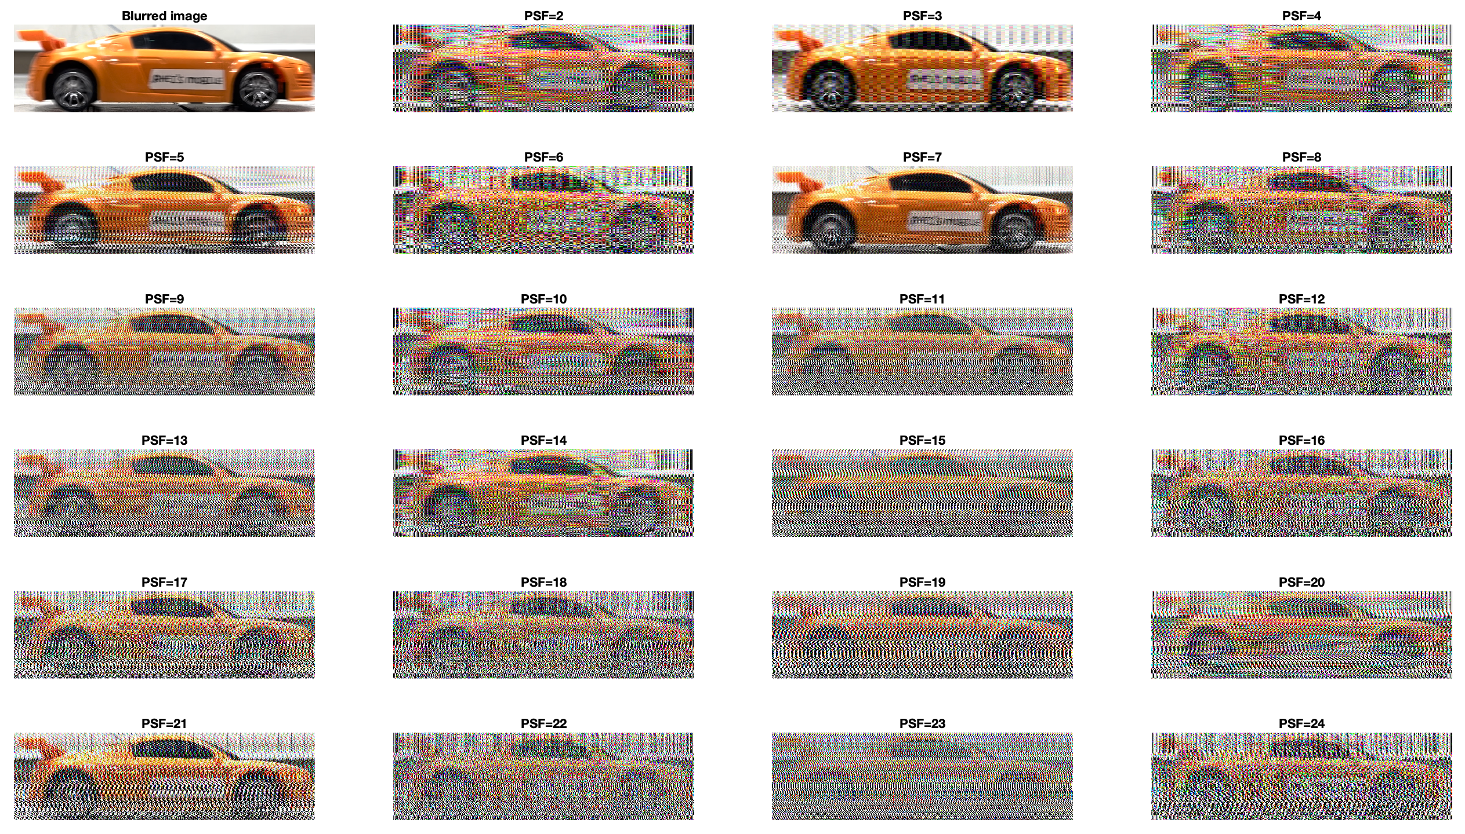
Part 2: Deblurring a real blurred image
As we can see in Figure 3, it seems that we can’t deblur the image using only the pixel offset as our parameter. Let’s try varying the NSR as well.
We need not to explore the PSF angle since the phone was kept on the ground still during recording.
Figure 3. Varying PSF pixel offset for NSR = 0, PSF type = ‘motion’, PSF angle = 0.

Slide 8
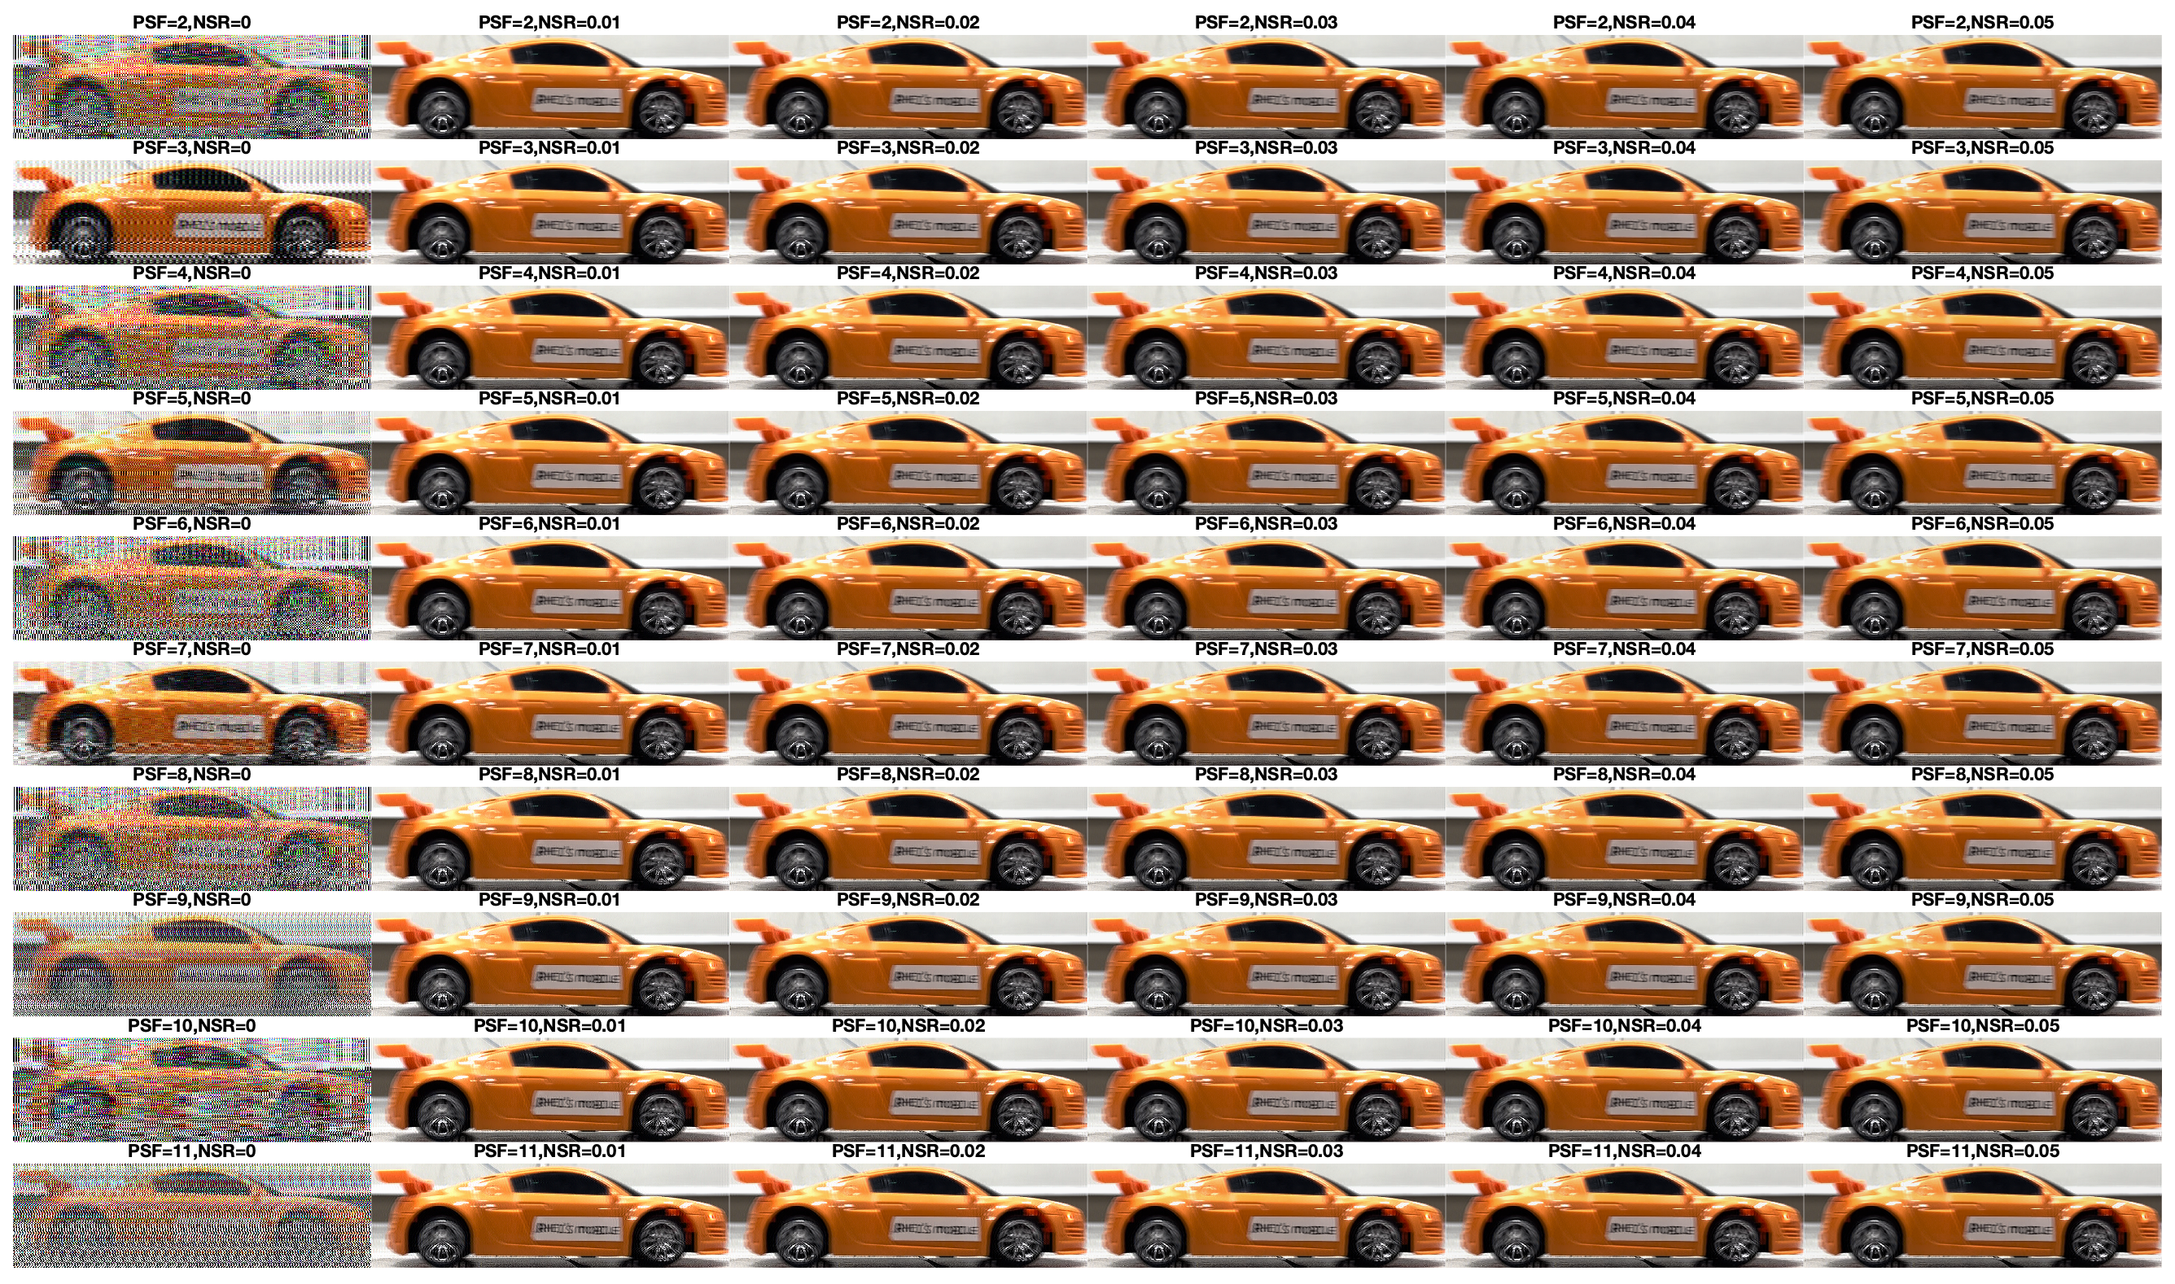
Part 2: Deblurring a real blurred image
Here are the results for varying PSF and NSR (more on the next slides)
Reference:
Figure 4. Varying PSF pixel offset and NSR

Slide 9
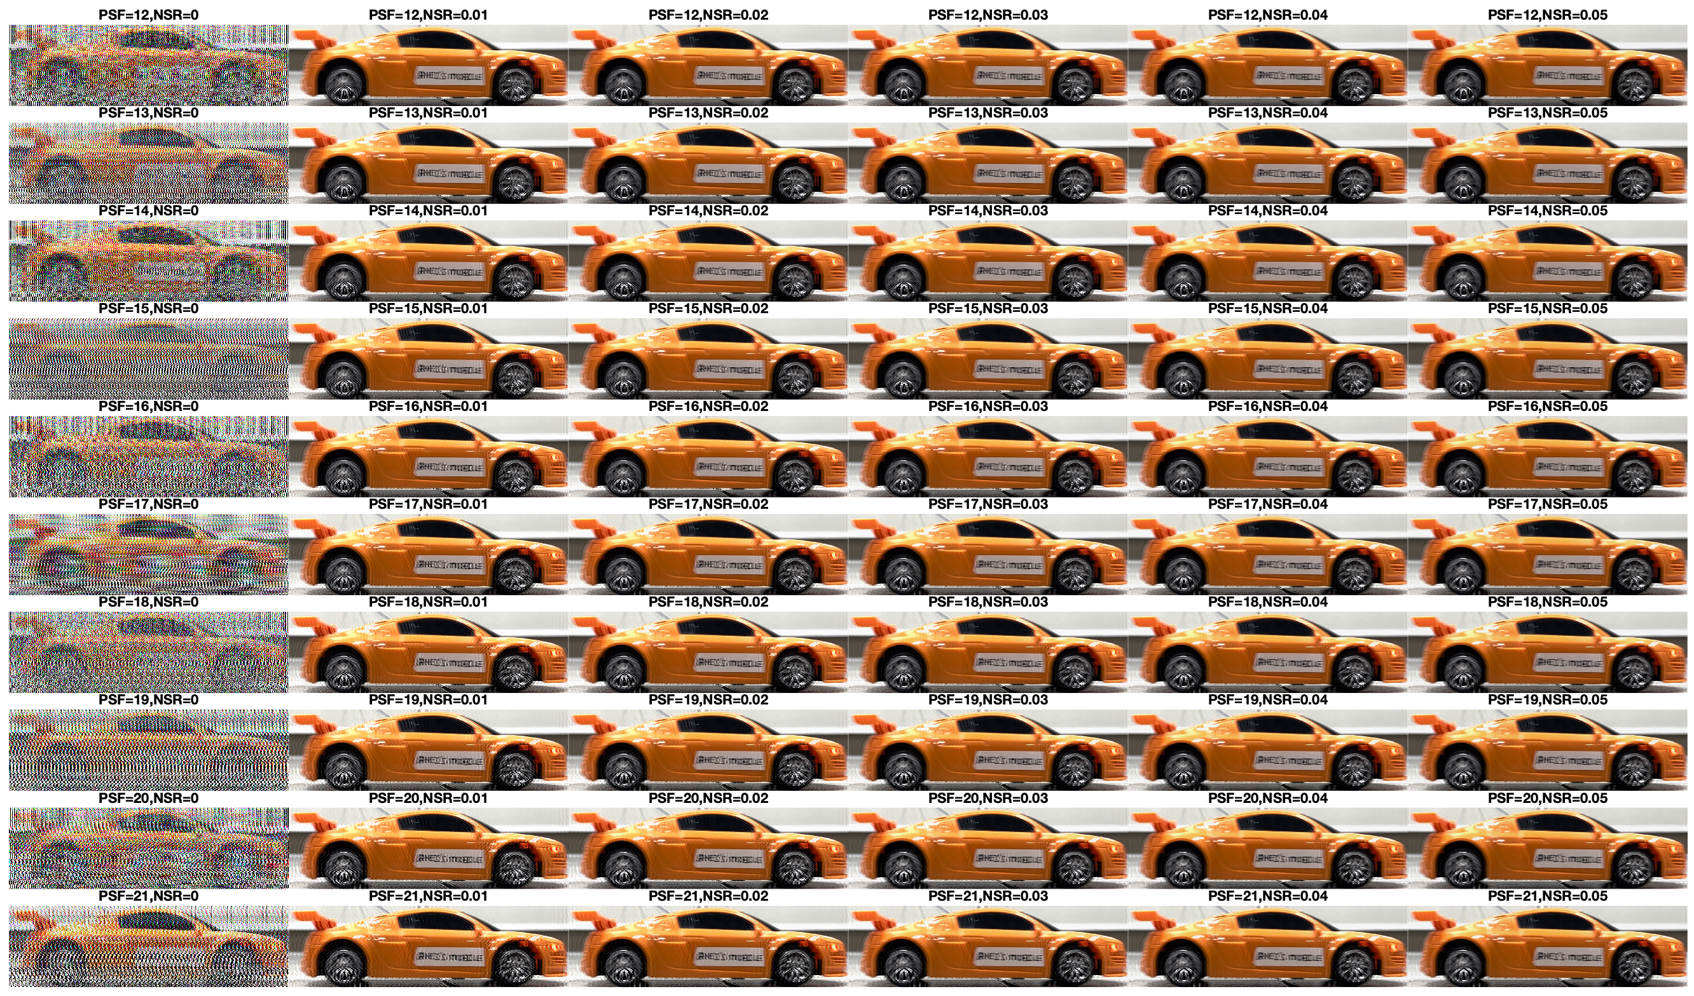
Reference:
NSR
Highlighted in yellow box is the best one yet.
PSF

Slide 10
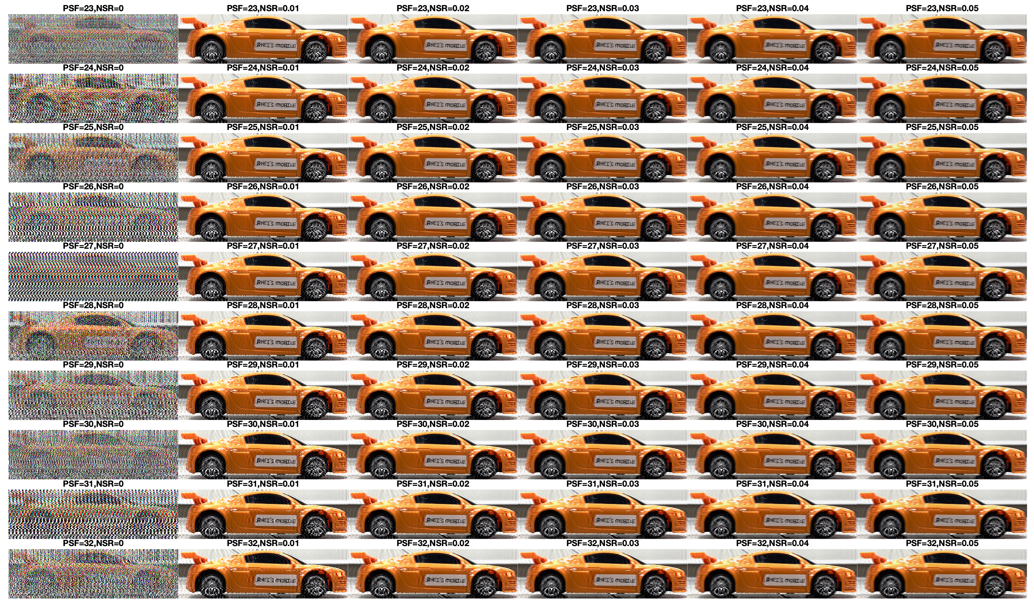
Reference:
NSR
Highlighted in yellow box is the best one yet.
PSF

Slide 11
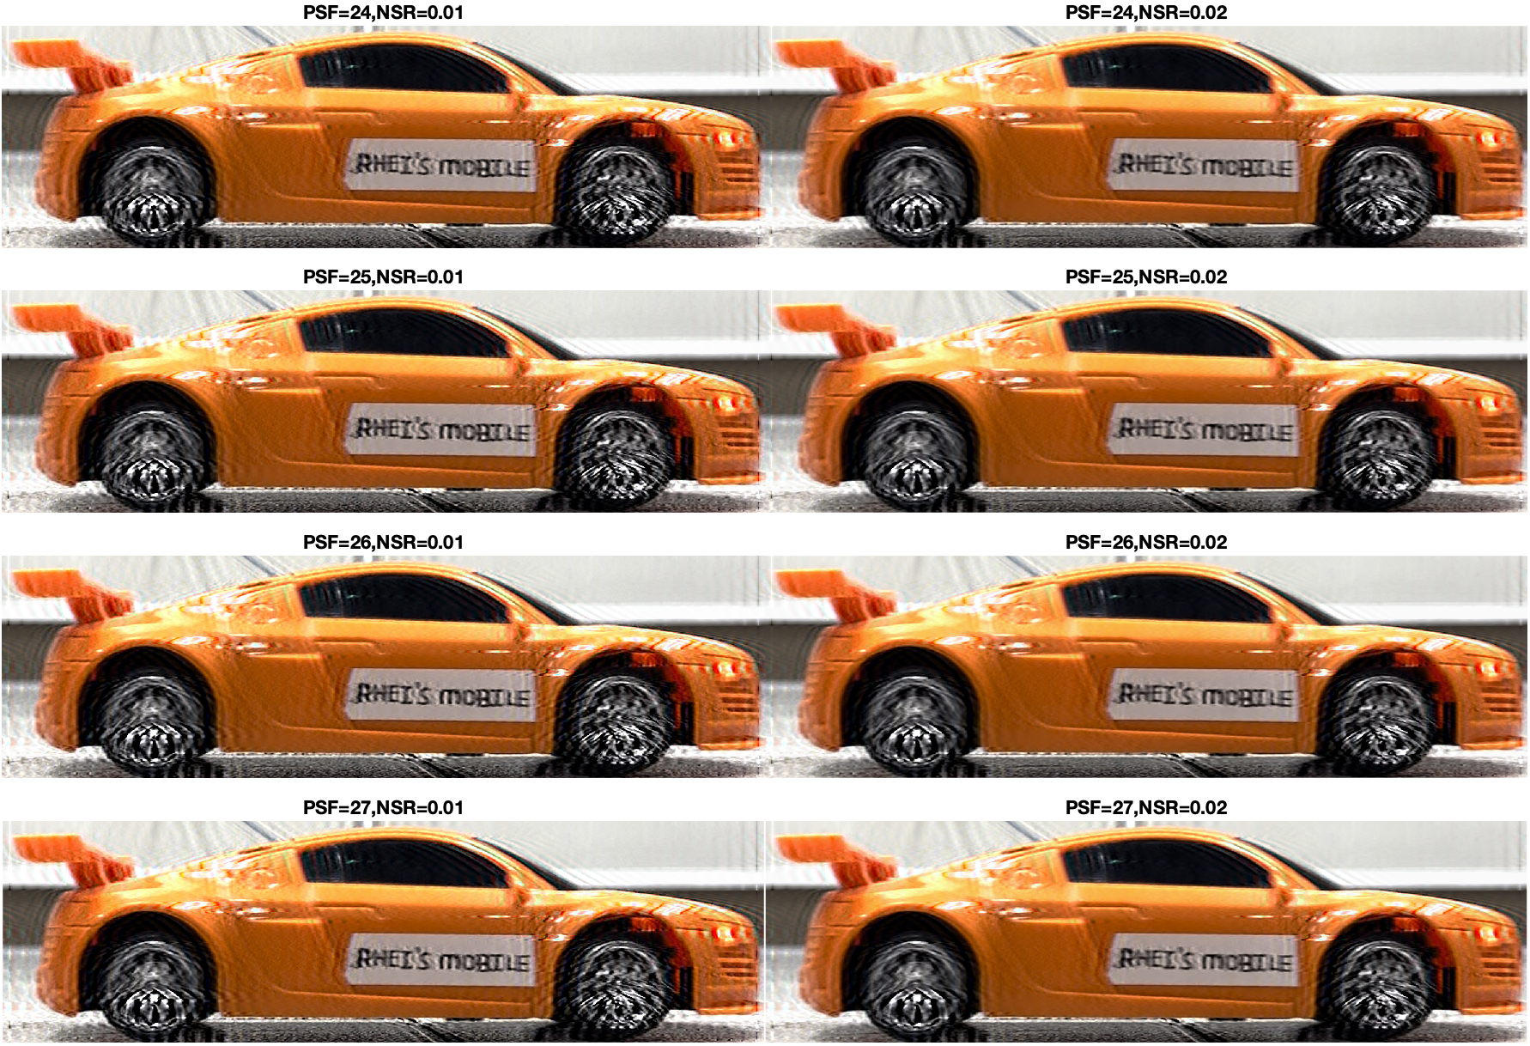


Blurred image:
Figure 5 shows the best reconstructed deblurred image that we found so far. Comparing to the original blurred image, although not perfect with some artifacts present, we were now able to read the letters!
Figure 5. Best reconstruction for PSF = 24-27 and NSR = 0.01-0.02

Slide 12
Blurred image:
But the problem is, how would we know which one is the best? Will we only base our judgement qualitatively? Or do we have a metric to do that?
Figure 5. Best reconstruction for PSF = 24-27 and NSR = 0.01-0.02

